Slide 1

Instructor Kick-off
Analyze A/B Test Results
Maximus Walker
© 2019 Udacity. All rights reserved.

Slide 2
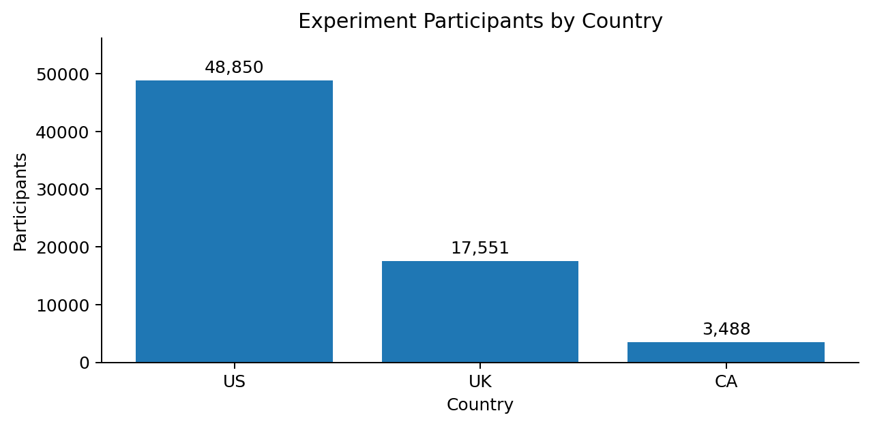
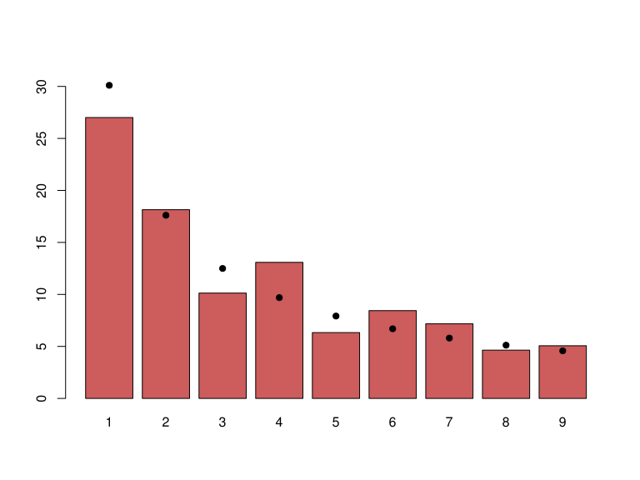
How Was The Experiment Implemented?​
Total Variant Visitors: 35,211
Total Control Participants: 34,678

Slide 3
Conversion Rates
 | U.S. | U.K. | CA
Control | 10.73% | 10.16% | 9.45%
Treatment | 15.78% | 14.87% | 15.40%
Executive Summary: Treatment users converted at a higher rate in the U.S., U.K., and Canada. After controlling for treatment, country was not statistically significant (UK p=0.905; US p=0.170, Canada baseline). Treatment-by-country interactions were also not significant, so the treatment advantage is broadly consistent across countries.

Slide 4
Experiment Results
Treatment Conversion Rate: 15.53%
Control Conversion Rate: 10.53%
Delta in Treatment vs. Control Conversion Rate: +5.01 percentage points
z statistic: 19.647
p-value (one-sided): 3.052e-86
Conclusion: The treatment page has a statistically significant higher conversion rate than the control page. The estimated lift is also practically meaningful in this experiment, so the evidence supports implementing the treatment page.

Slide 5
Country Results
Country main effects (Canada baseline):
• UK p-value = 0.9048
• US p-value = 0.1701
Treatment-by-country interactions:
• Treatment × UK p-value = 0.2887
• Treatment × US p-value = 0.3001
Conclusion: There is no statistically significant evidence that country independently changes conversion or that the treatment effect differs by country. The treatment effect remains the primary statistically significant predictor of conversion.

